Slide 1
Filipino Fishers on Ocean Going Vessels: A Case of Modern Day Slavery
Atty.Edwin Dela Cruz
April 16, 2024

Slide 2
Isolation at sea for months = Modern day Slavery
Isolation at sea for months, even years, makes escape difficult and often impossible. It is all too easy for these vessels to operate away from the reach of the law. Such a scenario, where fishing vessel captains rule with impunity, makes modern slavery at sea possible.
SEABOUND: THE JOURNEY TO MODERN SLAVERY ON THE HIGH SEAS. P. 6. Greenpeace and SBMI December 2019

Slide 3
Violation of POEA/ DMW Contract
The Philippines is a source of more than 10,000 Fishers working on Ocean Going Vessels. Although there is a nominal contract called the (POEA) Standard Agreement, now called the (DMW) Standard Agreement, stating the wages, hours of work, leave pay, overtime pay, holiday and regular rest day every week, this agreement is blatantly violated by shipowners and the master of the vessel.

Slide 4
Fishers endure the hardest, dirtiest and most dangerous work
Crewmembers are notoriously denied previously agreed wages, if they get paid at all, while some captains and boat owners ignore basic human rights, forcing fishers to endure extended periods at sea, under dangerous conditions. (UN FAO: International Symposium on Fisheries Sustainability, November 19, 2019 Rome)

Slide 5
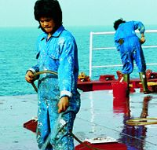
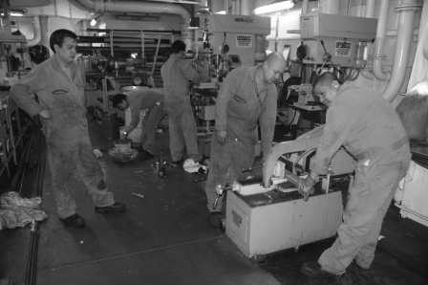
Lack of sleep
No shore leave
No rest day
No overtime pay
Low wages
No medical attention.

Slide 6
Modern Day Slavery at Sea – ILO,
Modern-day slavery is described as “any situation of exploitation that a person cannot refuse or leave because of threats, violence, coercion, deception, and/or abuse of power”. This includes “forced labour, debt bondage, forced marriage, slavery and slavery-like practices and human trafficking”.
Greenpeace ibid. p. 15.

Slide 7
Forced Labour worsened during the COVID 19 Pandemic
Many months stranded.
No sufficient food and water
No medical attention.
No contact with families.
An alliance of grassroots and seafarers rights advocates was formed in the Philippines in 2021 called the SEANETWORK for Seafarers Empowerment Advocates Networik.

Slide 9
Fishers in Crisis during Covid 19
Stranded
Shipowners abandoned them
FV Lu Qing Yuan Yu 286 and FV Lu Qing Yuan Yu 287 who have been stranded off the coast of Montevideo, Uruguay since March, 2020.
97 crew of several ships including FV Fu Yuan Yu who were stranded in China for several months were ultimately repatriated in July on board MV Star Mariner
Ocean Star 8688 and FV He Li 1 Hao.
FV Han Rong 349 Indian Ocean
Jenn Yih Song Seafoods Ltd of Kaohshung Taiwan and the manning agencies are the Global Maritime and Offshore Resources, Global Offshore, Global Master Marine Agency

Slide 10
After Covid 19, the new normal?
On wages
Isolation
No Family Contact
No timely payment of wages
Nominal $ 450 /month not followed
Lower than $ 740 Taiwan migrant fishers
No Overtime and Rest day work pay
No shore leave.
Isolated in the middle of the sea for months or even a year.
No financial security for illness, injury or death
No internet and access to phone.

Slide 11
Worsening conditions of fishers
Systemic Problem
Government Neglect
Illegal, Unreported and Unregulated IUU fishing and the prevalence of Flags of Convenience ships.
Lack of Philippine government action against the human trafficking and modern day slavery among Filipino fishers.
Refusal of the government even to ratify the ILO Convention 188
Include fishers in the proposed Magna Carta for Seafarers.
Labor Export Program

Slide 12
What must be done?
A. Fishers must know their rights, organize themselves, and collectively fight for these rights.
B. Fishers must unite with seafarers, dockers, migrant organizations, and advocates of fishers and seafarers rights.

Slide 13
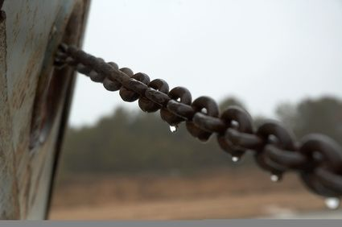
Unite with other
Seafarers,
Dockers,
Migrants, and
Families.

Slide 14
What must be done?
Ratify ILO Convention 188
Include Fishers in the Magna Carta for Seafarers. Amend ILO Maritime Labour Convention 2006 to cover Fishers.

Slide 15
Oppose Labor Export Program
Lowest wages, most difficult work, most hazardous work place, no government protection, no financial security,
Modern Day Slavery

Slide 16
Thank you
Edwin Dela Cruz
Email: edlaw76c@ gmail.com

