Slide 1
Thailand Sea fisheries and Protection of Sea Fishers under C. 188
Supang Chantavanich
Asian Research Center for Migration (ARCM)
Institute of Asian Studies, Chulalongkorn University , Thailand

Slide 2
Signing ceremony of C.188 in Geneva 2019
L
major aspect of illegality is related to the exploitation of Thai and migrant sea fishers. ARCM-ILO study in 2013 found three aspects of forced labor indicators practised among employers especially in the overseas fishing industry: wage withholding, lack of work contract, and inadequate and irregular rest hours.

Slide 3
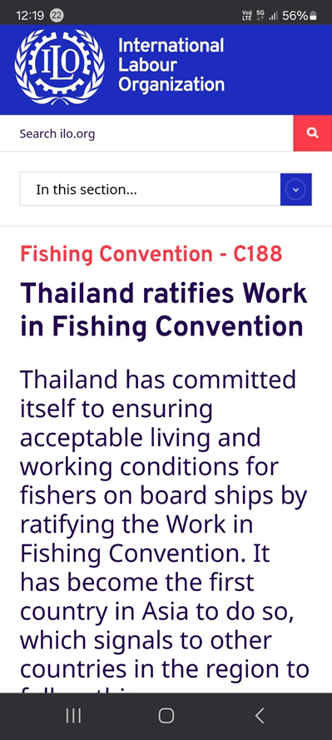

Slide 4
Major Conditions prior to Yellow Cards Issuance
Major aspect of illegality is related to the exploitation of Thai and migrant sea fishers. ARCM-ILO study in 2013 and ARCM 2022 found 4 aspects of forced labor indicators practised among employers especially in the overseas fishing industry:
wage withholding,
lack of work contract,
inadequate and irregular rest hours.
Death and disappearance at sea.

Slide 5
Example of Exploitation

Slide 6
New Move to Revise Measures in 2024
Transfer of sea fishers on board
Online labor inspection and Use of fisher’s ID card instead of seamen book & crew list at the Port In-Port Out (PIPO) centers
Onboard transfer of catches

Slide 7
Perspectives on Deregulation of C.188 from
Vessel owners
Media
CSOs
RTG Officials
Parliamentarians
Academics

Slide 8
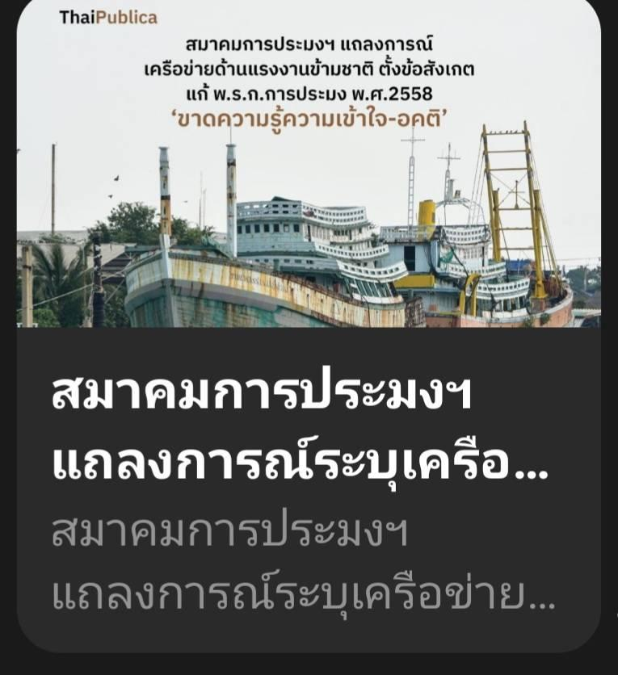
Protest from NFAT

Slide 9
NFAT complaints
Major complaints from vessel owners via National Fisheries Association of Thailand ( NFAT) call for the revision of the Ordinance to relax the measures
on- board transfer of catches and sea fishers
cancellation of the required namelist of sea fishers together with seamen book
pay slip to be submitted at the port-out inspection.

Slide 10
International media comment on current relaxation of Ordinance on Fisheries 2015
“Lawmakers draft new legislation that weakens seafarer protections, sparking fears of a return to the ‘bad old days’ of trafficked labour" in Thailand.”
The Telegraph

Slide 11
The Telegraph

Slide 12
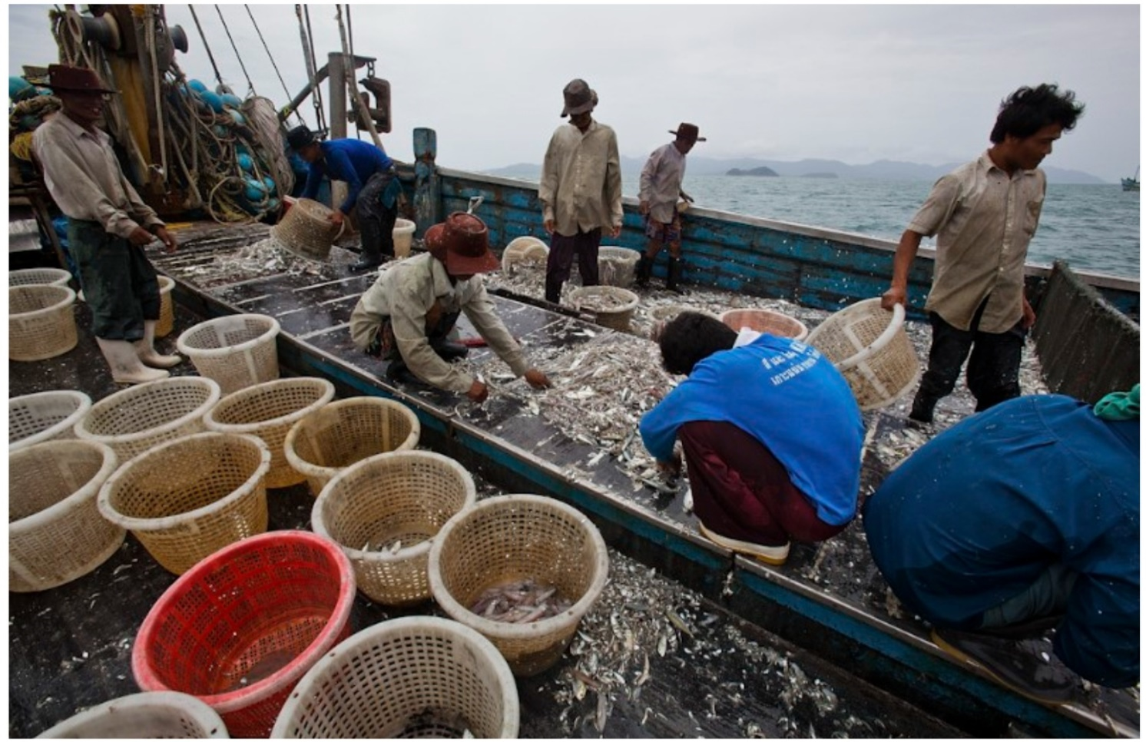
CSOs criticized such call for relax as the deregulation and deviation from C.188

Slide 14
Parliament the newly elected parliament agreed with the relaxation in the ongoing debates.

Slide 15
Department of Fisheries confirms that it will allow relaxation as not affecting C 188 and the well-being of fishers and vessel owners.

Slide 16
Academic & CSOs analysis of the impact of relaxation 1) Transfer of sea fishers on board: -against the regulation on commercial fishing vessels not to go fishing beyond the maximum period of 30 days per trip -Possible employment of new/unregistered sea fishers leading to labor abuse and vulnerability

Slide 17
Academic & CSOs analysis of the impact of relaxation (cont)
2) Online labor inspection and Use of fisher’s ID card instead of seamen book & crew list at the Port In-Port Out (PIPO) centers
Crew list and seamen book can protect workers for wage payment, identification for disappearance and death at sea
Reduction in the lengthy process of seamen book should be recommended instead.

Slide 18
Academic & CSOs analysis of the impact of relaxation (cont)
3) Onboard transfer of catches
Traceability challenges
Juvenile catches not identified/ reported in the logbook at piers

Slide 19
Thank you

